Slide 1
DSA 8301 – Stat Inference in Big Data
Lecture 3
Fitting Models to Data - I

Slide 2
References
Hogg, R. V., McKean, J., & Craig, A. T. (2005). Introduction to Mathematical Statistics. Pearson Education.
Efron, B., & Hastie, T. (2016). Computer age statistical inference (Vol. 5). Cambridge University Press.
Akritas, M. (2015). Probability & Statistics with R for Engineers and Scientists. Pearson Education

Slide 3
Introduction
In a typical statistical problem, we have a random variable X of interest, but its p.d.f or p.m.f is not known. We can classify the problem in one of two ways:
the distribution is completely unknown, or
the form of the distribution is know down to a parameter(s)
In the second case, we assume a model for the distribution
When a model for the distribution of the data is assumed, it is typically of interest to estimate the parameters of the assumed model.
Notes:
The genetic material that carries the instructions that allow cells to make proteins
Composed of a sugar phosphate backbone from which four nitrogenous bases- adenine (A), guanine (G), cytosine (C), and thymine (T) protrude
Arranged in a double helix- two strands are held together by specific pairings between bases A – T pair and G – C pair

Slide 4
Introduction
For example,
if it can be reasonably assumed that the data came from a uniform distribution it would be of interest to estimate the two endpoints,
if it can be reasonably assumed that the data came from a gamma or a Weibull distribution, both of which are governed by parameters denoted by α and β, it would be of interest to estimate these two parameters,
if it can be reasonably assumed that the data came from the normal simple linear regression model, it would be of interest to estimate the regression line (i.e., the slope and the intercept) and the intrinsic error variance.
if X has an exponential distribution, then it would be of interest to estimate the mean
If X has the binomial distribution, then it would be of interest to estimate the parameter p
In statistical jargon, estimating the parameters of a particular model from a data set is called fitting the model to the data.
Notes:
The genetic material that carries the instructions that allow cells to make proteins
Composed of a sugar phosphate backbone from which four nitrogenous bases- adenine (A), guanine (G), cytosine (C), and thymine (T) protrude
Arranged in a double helix- two strands are held together by specific pairings between bases A – T pair and G – C pair

Slide 5
Introduction
Three methods of fitting models to data are:
the method of moments,
the method of maximum likelihood, and
the method of least squares.
The last is most commonly used for fitting regression models.
Estimation of the model parameters leads to an alternative way for estimating population parameters, called model-based estimation.
Notes:
The genetic material that carries the instructions that allow cells to make proteins
Composed of a sugar phosphate backbone from which four nitrogenous bases- adenine (A), guanine (G), cytosine (C), and thymine (T) protrude
Arranged in a double helix- two strands are held together by specific pairings between bases A – T pair and G – C pair

Slide 6
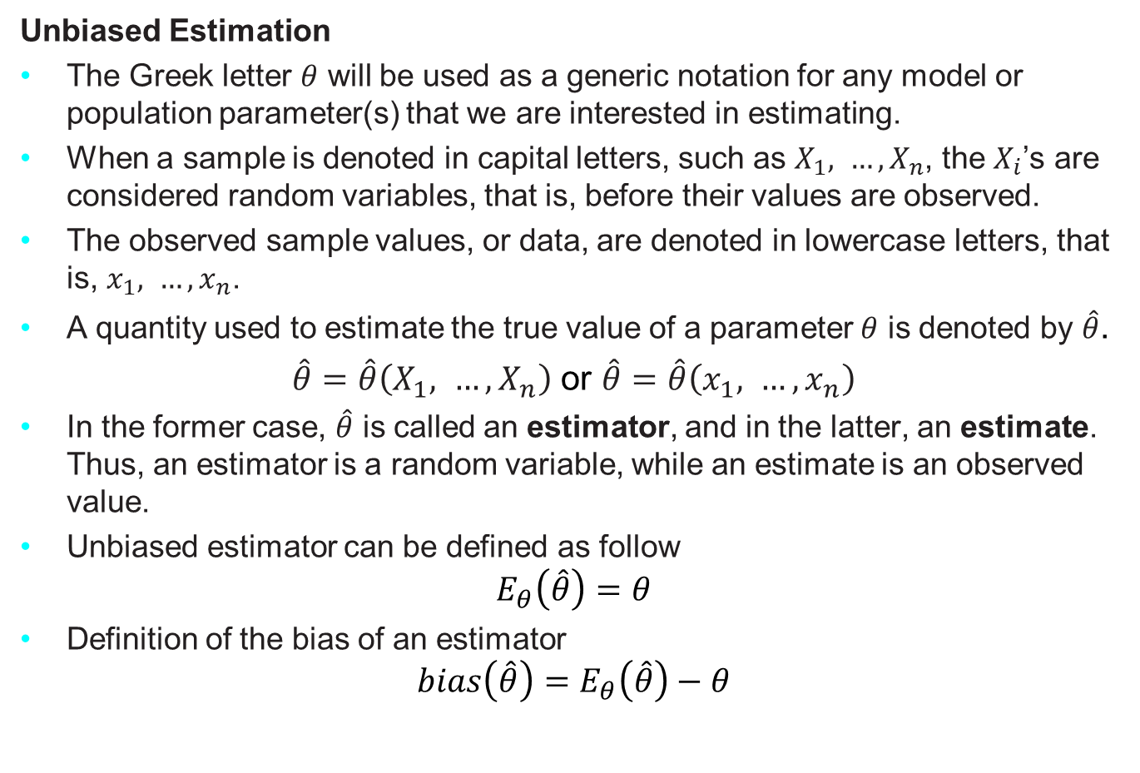
Some Estimation Concepts
Unbiased Estimation
The Greek letter $θ$ will be used as a generic notation for any model or population parameter(s) that we are interested in estimating.
When a sample is denoted in capital letters, such as $X_{1}, …,X_{n}$, the $X_{i}$’s are considered random variables, that is, before their values are observed.
The observed sample values, or data, are denoted in lowercase letters, that is, $x_{1}, …,x_{n}$.
A quantity used to estimate the true value of a parameter $θ$ is denoted by $\hat{θ}$.
$\hat{θ}=\hat{θ}\left(X_{1}, …,X_{n}\right)$ or $\hat{θ}=\hat{θ}\left(x_{1}, …,x_{n}\right)$
In the former case, $\hat{θ}$ is called an estimator, and in the latter, an estimate. Thus, an estimator is a random variable, while an estimate is an observed value.
Unbiased estimator can be defined as follow
$$E_{θ}\left(\hat{θ}\right)=θ$$
Definition of the bias of an estimator
$$bias\left(\hat{θ}\right)=E_{θ}\left(\hat{θ}\right)−θ$$
Notes:
The genetic material that carries the instructions that allow cells to make proteins
Composed of a sugar phosphate backbone from which four nitrogenous bases- adenine (A), guanine (G), cytosine (C), and thymine (T) protrude
Arranged in a double helix- two strands are held together by specific pairings between bases A – T pair and G – C pair

Slide 7
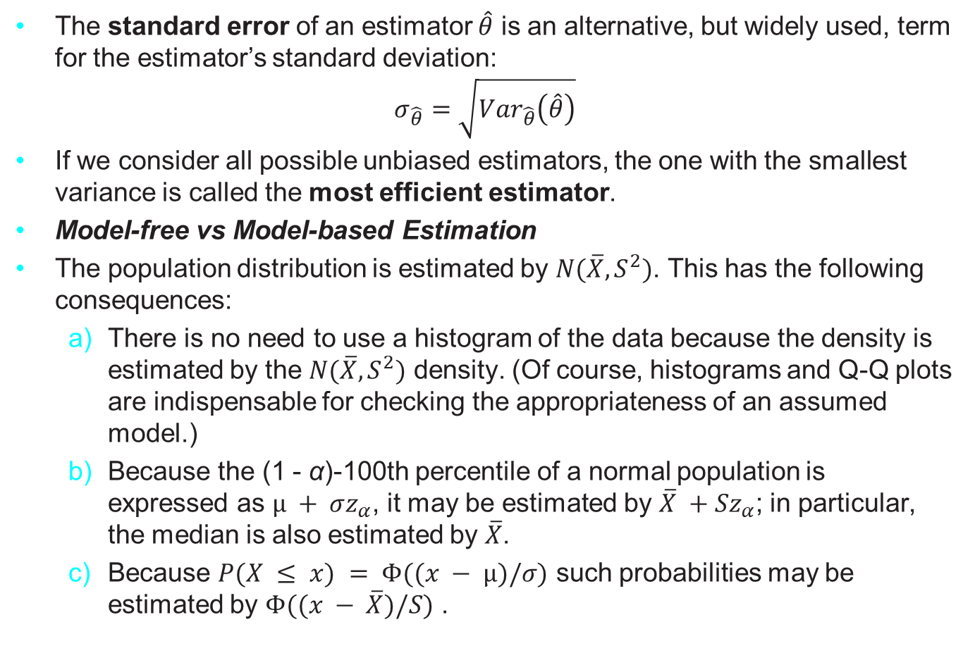
Some Estimation Concepts
The standard error of an estimator $\hat{θ}$ is an alternative, but widely used, term for the estimator’s standard deviation:
$$σ_{\hat{θ}}=\sqrt{{Var}_{\hat{θ}}\left(\hat{θ}\right)}$$
If we consider all possible unbiased estimators, the one with the smallest variance is called the most efficient estimator.
Model-free vs Model-based Estimation
The population distribution is estimated by $N(\overline{X}, S^{2})$. This has the following consequences:
There is no need to use a histogram of the data because the density is estimated by the $N(\overline{X}, S^{2})$ density. (Of course, histograms and Q-Q plots are indispensable for checking the appropriateness of an assumed model.)
Because the (1 - α)-100th percentile of a normal population is expressed as $µ + σz_{α}$, it may be estimated by $\overline{X} +Sz_{α}$; in particular, the median is also estimated by $\overline{X}$.
Because $P(X ≤ x) = Φ((x − µ)/σ)$ such probabilities may be estimated by $Φ((x − \overline{X})/S)$ .
Notes:
The genetic material that carries the instructions that allow cells to make proteins
Composed of a sugar phosphate backbone from which four nitrogenous bases- adenine (A), guanine (G), cytosine (C), and thymine (T) protrude
Arranged in a double helix- two strands are held together by specific pairings between bases A – T pair and G – C pair

Slide 8
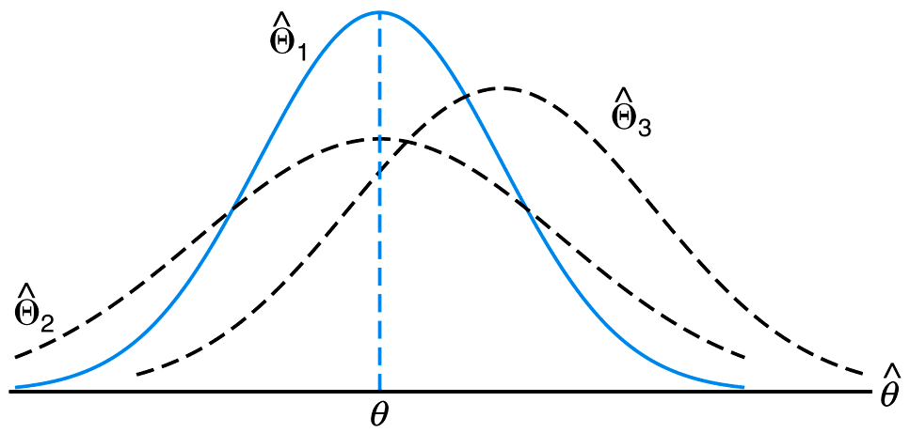
Which is the efficient estimator here?
Notes:
The genetic material that carries the instructions that allow cells to make proteins
Composed of a sugar phosphate backbone from which four nitrogenous bases- adenine (A), guanine (G), cytosine (C), and thymine (T) protrude
Arranged in a double helix- two strands are held together by specific pairings between bases A – T pair and G – C pair

Slide 9
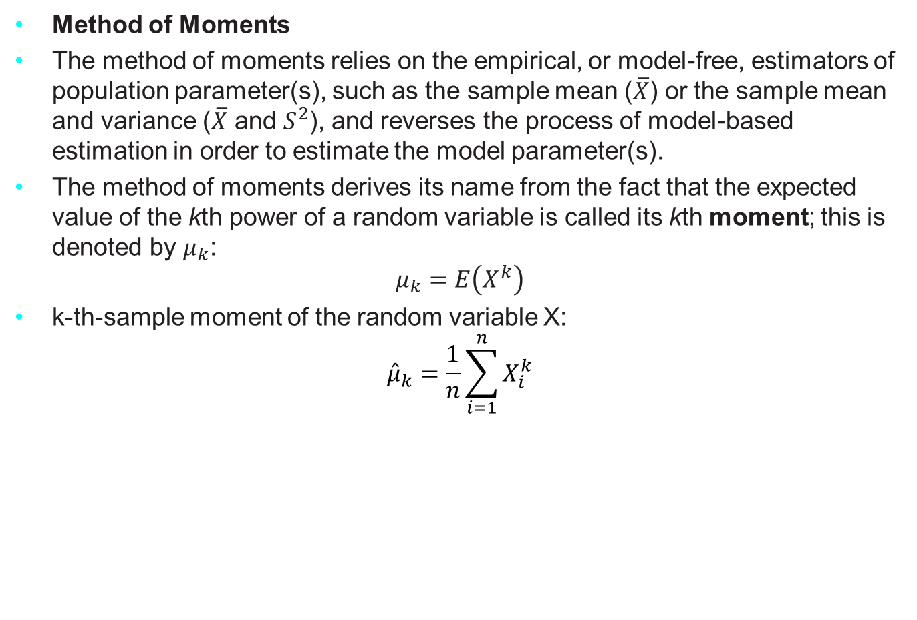
Methods for Fitting Models to Data
Method of Moments
The method of moments relies on the empirical, or model-free, estimators of population parameter(s), such as the sample mean ($\overline{X}$) or the sample mean and variance ($\overline{X}$ and $S^{2}$), and reverses the process of model-based estimation in order to estimate the model parameter(s).
The method of moments derives its name from the fact that the expected value of the kth power of a random variable is called its kth moment; this is denoted by $μ_{k}$:
$$μ_{k}=E\left(X^{k}\right)$$
k-th-sample moment of the random variable X:
$${\hat{μ}}_{k}=\frac{1}{n}\sum_{i=1}^{n}{X_{i}^{k}}$$
Notes:
The genetic material that carries the instructions that allow cells to make proteins
Composed of a sugar phosphate backbone from which four nitrogenous bases- adenine (A), guanine (G), cytosine (C), and thymine (T) protrude
Arranged in a double helix- two strands are held together by specific pairings between bases A – T pair and G – C pair

Slide 10
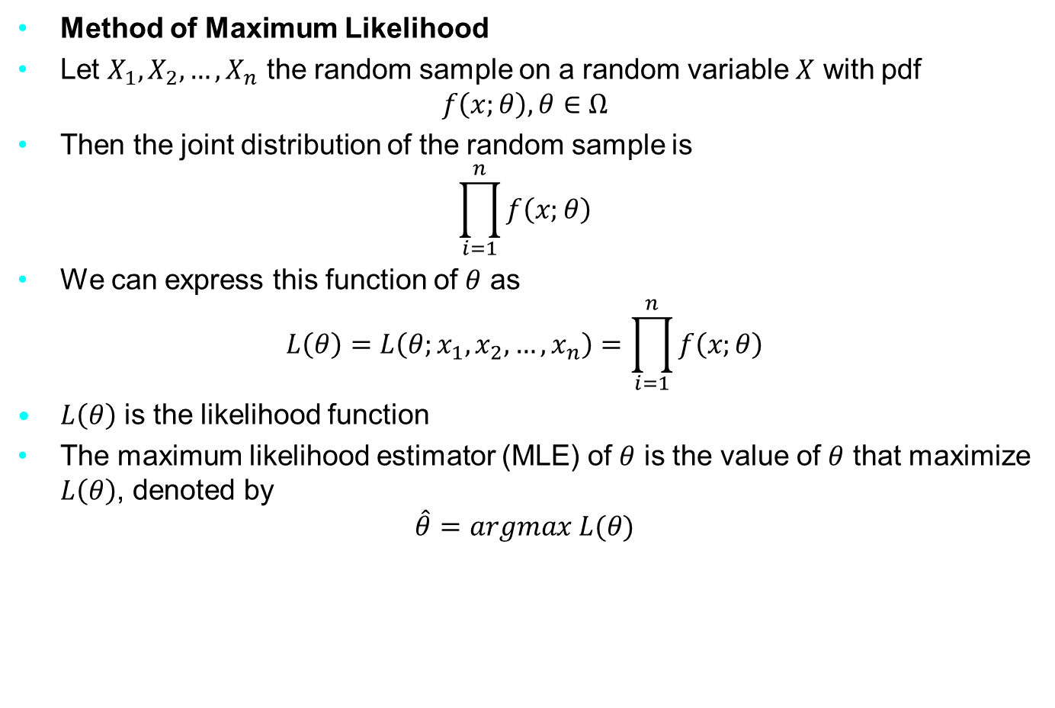
Methods for Fitting Models to Data
Method of Maximum Likelihood
Let $X_{1}, X_{2}, …, X_{n}$ the random sample on a random variable $X$ with pdf
$$f\left(x;θ\right), θ∈Ω$$
Then the joint distribution of the random sample is
$$\prod_{i=1}^{n}{f\left(x;θ\right)}$$
We can express this function of $θ$ as
$$L\left(θ\right)=L\left(θ;x_{1}, x_{2}, …, x_{n}\right)=\prod_{i=1}^{n}{f\left(x;θ\right)}$$
$L\left(θ\right)$ is the likelihood function
The maximum likelihood estimator (MLE) of $θ$ is the value of $θ$ that maximize $L\left(θ\right)$, denoted by
$$\hat{θ}=argmax L(θ)$$
Notes:
The genetic material that carries the instructions that allow cells to make proteins
Composed of a sugar phosphate backbone from which four nitrogenous bases- adenine (A), guanine (G), cytosine (C), and thymine (T) protrude
Arranged in a double helix- two strands are held together by specific pairings between bases A – T pair and G – C pair

Slide 11
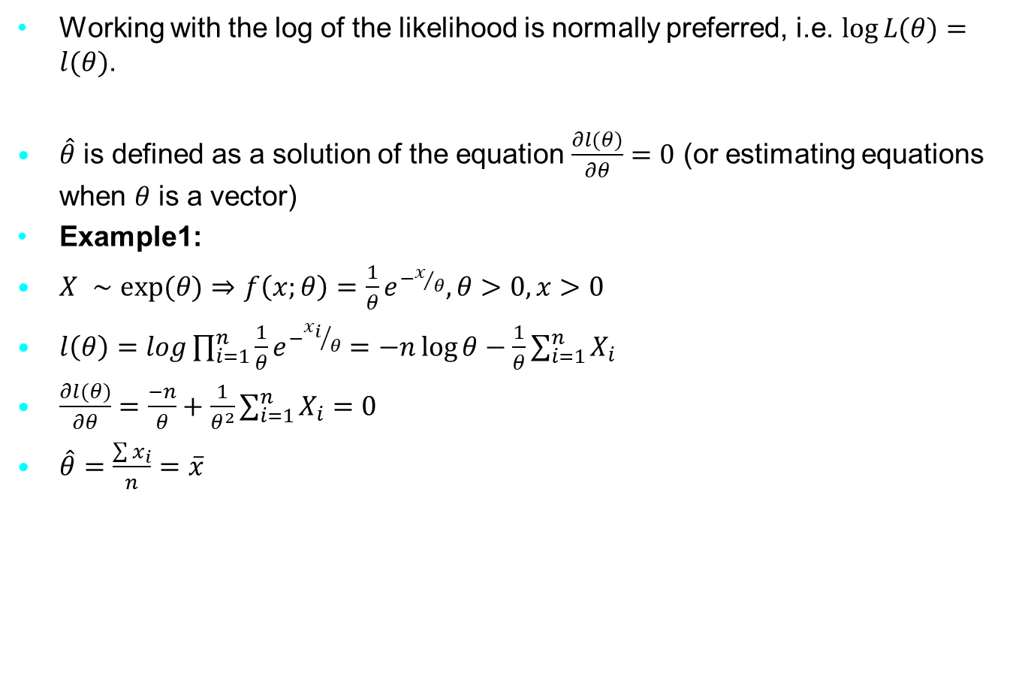
Methods for Fitting Models to Data
Working with the log of the likelihood is normally preferred, i.e. $\log{L(θ)}=l(θ)$.
$\hat{θ}$ is defined as a solution of the equation $\frac{∂l(θ)}{∂θ}=0$ (or estimating equations when $θ$ is a vector)
Example1:
$X ∼\exp{(θ)}$ $⇒$ $f\left(x;θ\right)=\frac{1}{θ}e^{−x/θ}, θ>0, x>0$
$l\left(θ\right)=log\prod_{i=1}^{n}{\frac{1}{θ}}e^{−{x_{i}}/θ}=−n\log{θ}−\frac{1}{θ}\sum_{i=1}^{n}{X_{i}}$
$\frac{∂l(θ)}{∂θ}=\frac{−n}{θ}+\frac{1}{θ^{2}}\sum_{i=1}^{n}{X_{i}}=0$
$\hat{θ}=\frac{\sum{x_{i}}}{n}=\overline{x}$
Notes:
The genetic material that carries the instructions that allow cells to make proteins
Composed of a sugar phosphate backbone from which four nitrogenous bases- adenine (A), guanine (G), cytosine (C), and thymine (T) protrude
Arranged in a double helix- two strands are held together by specific pairings between bases A – T pair and G – C pair

Slide 12
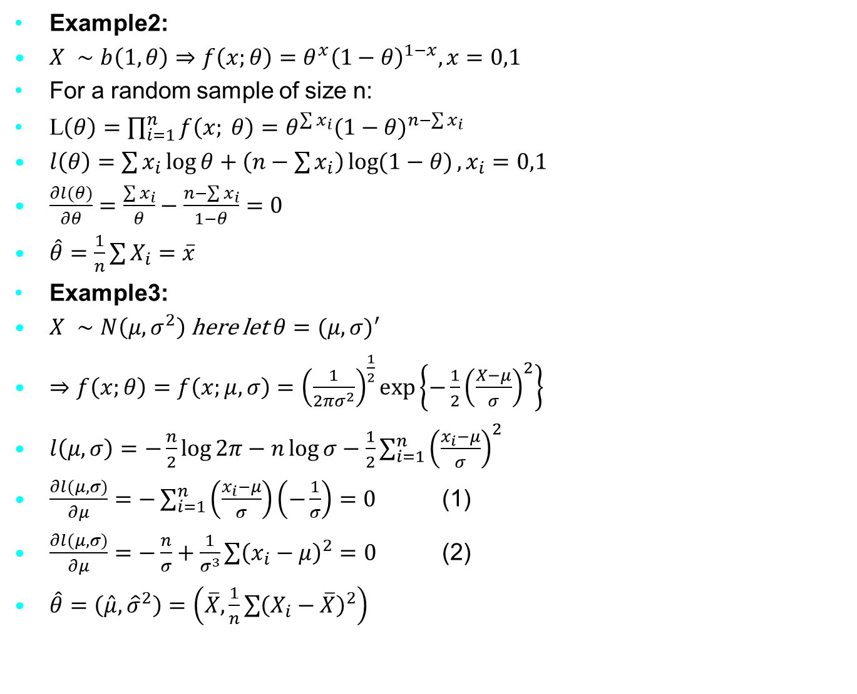
Methods for Fitting Models to Data
Example2:
$X ∼b\left(1, θ\right)⇒f\left(x;θ\right)=θ^{x}{\left(1−θ\right)}^{1−x}, x=0,1$
For a random sample of size n:
L$\left(θ\right)=\prod_{i=1}^{n}{f\left(x; θ\right)=θ^{\sum{x_{i}}}{(1−θ)}^{n−\sum{x_{i}}}}$
$l\left(θ\right)=\sum{x_{i}}\log{θ}+\left(n−\sum{x_{i}}\right)\log{(1−θ)}, x_{i}=0,1$
$\frac{∂l(θ)}{∂θ}=\frac{\sum{x_{i}}}{θ}−\frac{n−\sum{x_{i}}}{1−θ}=0$
$\hat{θ}=\frac{1}{n}\sum{X_{i}}=\overline{x}$
Example3:
$X ∼N\left(μ, σ^{2}\right)$ here let $θ={(μ,σ)}^{′}$
$⇒f\left(x;θ\right)=f\left(x;μ,σ\right)={\left(\frac{1}{2πσ^{2}}\right)}^{\frac{1}{2}}\exp\left\{−\frac{1}{2}{\left(\frac{X−μ}{σ}\right)}^{2}\right\}$
$l\left(μ,σ\right)=−\frac{n}{2}\log{2π}−n\log{σ−\frac{1}{2}}\sum_{i=1}^{n}{{\left(\frac{x_{i}−μ}{σ}\right)}^{2}}$
$\frac{∂l(μ,σ)}{∂μ}=−\sum_{i=1}^{n}{\left(\frac{x_{i}−μ}{σ}\right)\left(−\frac{1}{σ}\right)}=0$ (1)
$\frac{∂l(μ,σ)}{∂μ}=−\frac{n}{σ}+\frac{1}{σ^{3}}\sum{{\left(x_{i}−μ\right)}^{2}}=0$ (2)
$\hat{θ}=\left(\hat{μ},{\hat{σ}}^{2}\right)=\left(\overline{X}, \frac{1}{n}\sum{{\left(X_{i}−\overline{X}\right)}^{2}}\right)$
Notes:
The genetic material that carries the instructions that allow cells to make proteins
Composed of a sugar phosphate backbone from which four nitrogenous bases- adenine (A), guanine (G), cytosine (C), and thymine (T) protrude
Arranged in a double helix- two strands are held together by specific pairings between bases A – T pair and G – C pair

Slide 13
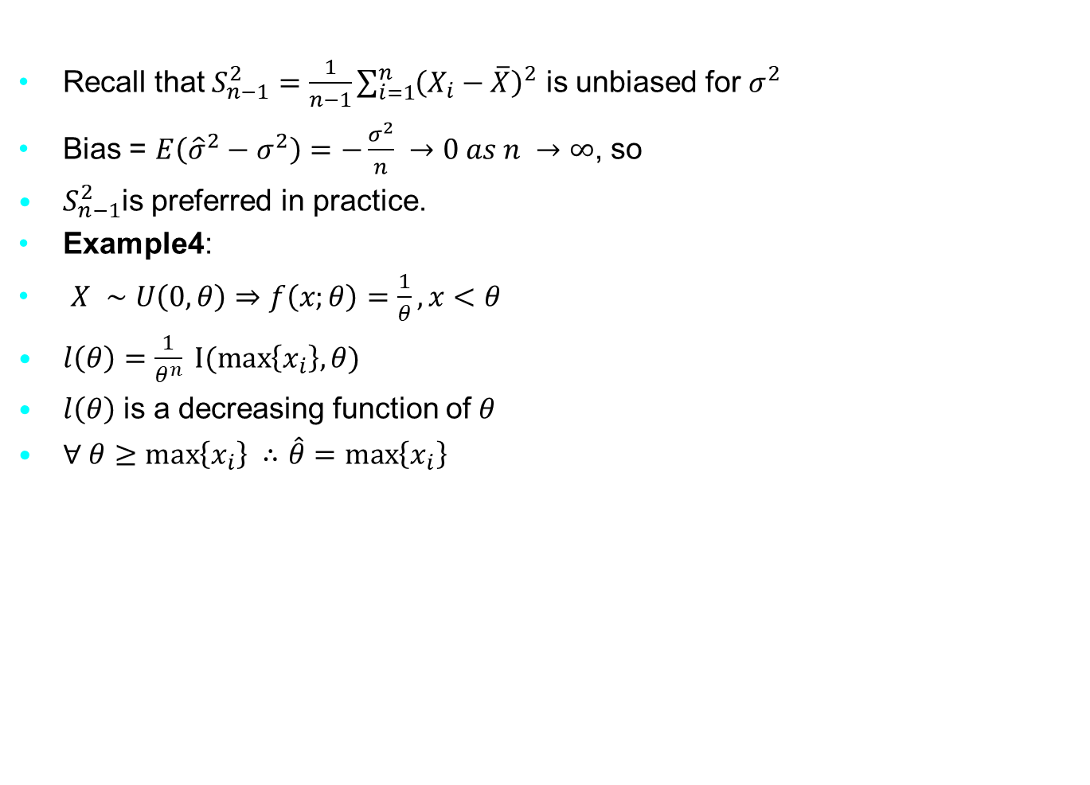
Methods for Fitting Models to Data
Recall that $S_{n−1}^{2}=\frac{1}{n−1}\sum_{i=1}^{n}{{\left(X_{i}−\overline{X}\right)}^{2}}$ is unbiased for $σ^{2}$
Bias = $E\left({\hat{σ}}^{2}−σ^{2}\right)=−\frac{σ^{2}}{n} →0 as n →∞$, so
$S_{n−1}^{2}$is preferred in practice.
Example4:
$X ∼U\left(0, θ\right)⇒f\left(x;θ\right)=\frac{1}{θ}, x<θ$
$l\left(θ\right)=\frac{1}{θ^{n}} I(\max\left\{x_{i}\right\},θ)$
$l\left(θ\right)$ is a decreasing function of $θ$
$∀ θ≥\max\left\{x_{i}\right\} ∴\hat{θ}=\max\left\{x_{i}\right\}$
Notes:
The genetic material that carries the instructions that allow cells to make proteins
Composed of a sugar phosphate backbone from which four nitrogenous bases- adenine (A), guanine (G), cytosine (C), and thymine (T) protrude
Arranged in a double helix- two strands are held together by specific pairings between bases A – T pair and G – C pair

Slide 14
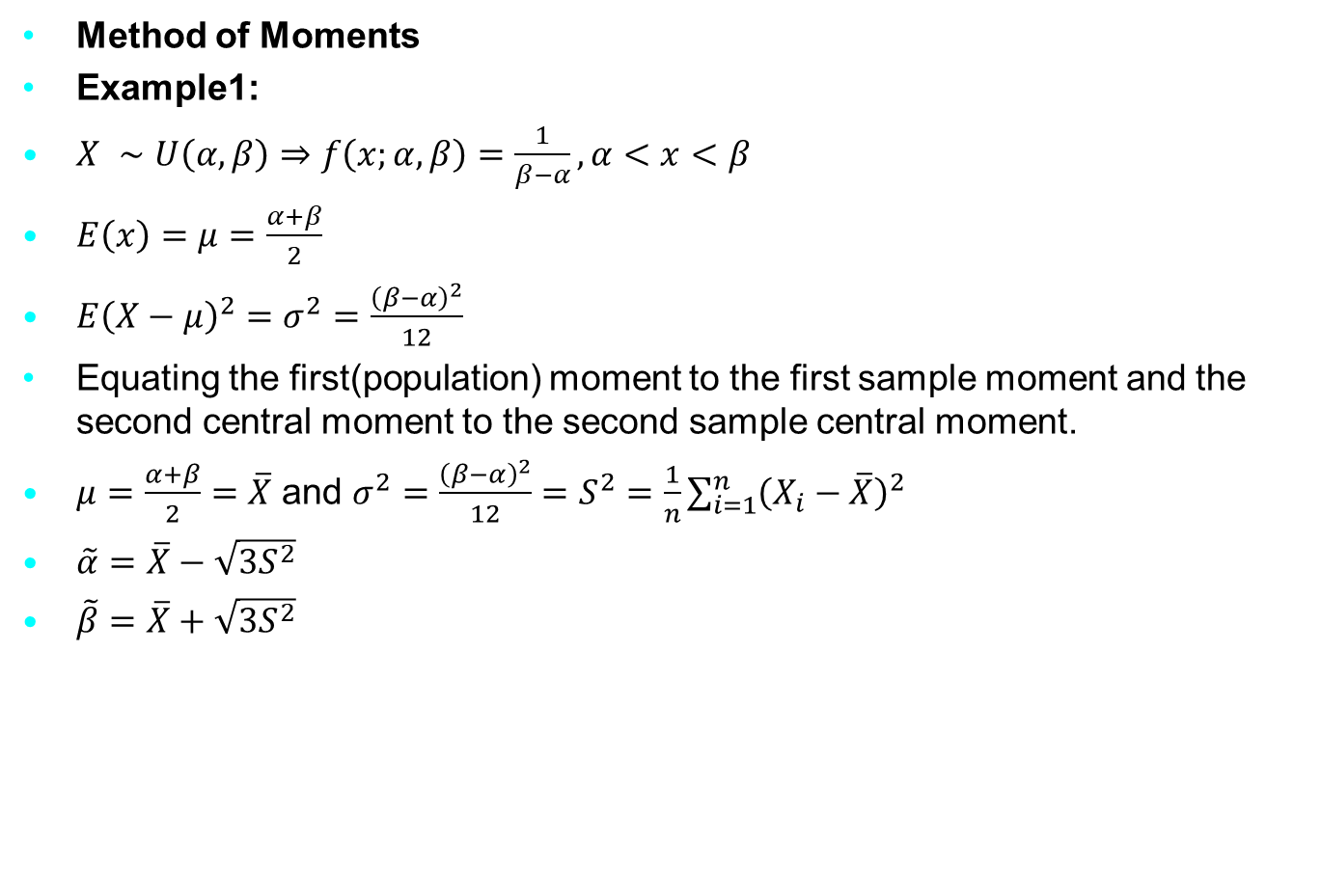
Methods for Fitting Models to Data
Method of Moments
Example1:
$X ∼U\left(α, β\right)⇒f\left(x;α,β\right)=\frac{1}{β−α}, α<x<β$
$E\left(x\right)=μ=\frac{α+β}{2}$
$E{\left(X−μ\right)}^{2}=σ^{2}=\frac{{\left(β−α\right)}^{2}}{12}$
Equating the first(population) moment to the first sample moment and the second central moment to the second sample central moment.
$μ=\frac{α+β}{2}=\overline{X}$ and $σ^{2}=\frac{{\left(β−α\right)}^{2}}{12}=S^{2}=\frac{1}{n}\sum_{i=1}^{n}{{\left(X_{i}−\overline{X}\right)}^{2}}$
$\tilde{α}=\overline{X}−\sqrt{3S^{2}}$
$\tilde{β}=\overline{X}+\sqrt{3S^{2}}$
Notes:
The genetic material that carries the instructions that allow cells to make proteins
Composed of a sugar phosphate backbone from which four nitrogenous bases- adenine (A), guanine (G), cytosine (C), and thymine (T) protrude
Arranged in a double helix- two strands are held together by specific pairings between bases A – T pair and G – C pair

Slide 15

Methods for Fitting Models to Data
Example2:
Let $X∼Poisson(λ)$
$f\left(x;λ\right)=\frac{λ^{x}e^{−λ}}{x!}, x=0, 1, 2, …$
$E\left(X\right)=μ=λ=\overline{X}$
Exercise (on your own):
Let $X∼ Γ(α, β)$, find the MME of $α$ and $β$
Notes:
The genetic material that carries the instructions that allow cells to make proteins
Composed of a sugar phosphate backbone from which four nitrogenous bases- adenine (A), guanine (G), cytosine (C), and thymine (T) protrude
Arranged in a double helix- two strands are held together by specific pairings between bases A – T pair and G – C pair

